Slide 1
Product, Services, and Brands
Chapter: 8

Slide 2


Slide 3
Value-Driven Marketing
Value
A customer’s subjective assessment of benefits relative to the costs in determining the worth of a product
Customer value = customer benefits – customer costs
Customer benefits
Anything desired by the customer that is received in an exchange
Customer costs
Anything a customer gives up in an exchange for benefits
Monetary price of the benefit
Search costs (time and effort) to locate the product
Risks associated with the exchange

Slide 4
Benefits
Consumers don’t buy products; they buy benefits
Functional benefits: relating to the practical purpose a product serves
Psychological benefits: relating to how a product makes one feel

Slide 5
What is a Product?
Whatever is offered for “sale” in a marketing exchange
Can be tangible goods (Laptop), services (VU education), ideas (Don’t smoke), places (Muree hills ), persons (sportsman).

Slide 6
Definitions
Product
Anything offered to a market for attention, acquisition, use, or consumption that might satisfy a need or want.
Service
Any activity or benefit that one party can offer to another that is essentially intangible and does not result in ownership of anything.

Slide 7
Levels of Products

Slide 8
Augmented
Product
Installation
Packaging
Brand
Name
Features
Delivery
& Credit
After-
Sale
Service
Core
Benefit or
Service
Quality
Level
Design
Warranty
Core
Product
Actual
Product
Notes:
Product Levels
This CTR corresponds to Figure 8-1 on p. 239 and relates to the material on pp. 239-240.
Product
A product is anything that can be offered to a market for attention, acquisition, use, or consumption and that might satisfy a want or need. Products can be physical objects, services, persons, places, organizations, and ideas.
Product Levels
Core Product. This concept refers to the use-benefit, problem-solving service that the consumer is really buying when purchasing a product.
Actual Product. The actual product is the tangible product or intangible service that serves as the medium for receiving core product benefits. Five characteristics:
Quality Level refers to product performance.
Features include combinations of product attributes.
Design consists of aesthetic or ergonomic aspects of the product.
Brand Name may help consumers position and identify the product.
Packaging serves to both protect the product and to promote it to consumers.
Augmented Product. The augmented consists of the measures taken to help the consumer put the actual product to sustained use. Measures can include installation, delivery & credit, warranties, and after sale service.

Slide 9
Product Classifications
Consumer products
Industrial products

Slide 10
Product Classifications Consumer Products
Consumer products are products and services for personal consumption
Classified by how consumers buy them
Convenience products
Shopping products
Specialty products
Unsought products

Slide 11
Product Classifications Consumer Products
Convenience products are consumer products and services that the customer usually buys frequently, immediately, and with a minimum comparison and buying effort
Low price
Widespread distribution
Mass promotion by producer
E.g:
Newspapers
Candy
Fast food

Slide 12
Product Classifications Consumer Products
Shopping products are consumer products and services that the customer compares carefully on suitability, quality, price, and style
*less frequent purchases
*higher price
*selective distribution in fewer outlets
*advertising & personal selling by both producer and resellers
Furniture
Clothing
Major Appliances

Slide 13
Product Classifications Consumer Products
Specialty products are consumer products and services with unique characteristics or brand identification for which a significant group of buyers is willing to make a special purchase effort
*strong brand preference and loyalty
*little comparison of brands
*high price
*exclusive distribution
*more carefully targeted promotion by producers and resellers
Luxury goods
Designer clothes
High-end electronics

Slide 14
Product Classifications Consumer Products
Unsought products are consumer products that the consumer does not know about or knows about but does not normally think of buying
*little product awareness
*price varies
*distribution varies
*aggressive advertising & personal selling by producer & reseller
Life insurance
Funeral services
Blood donations

Slide 15
Product Classifications Industrial Products
Industrial products are products purchased for further processing or for use in conducting a business
Classified by the purpose for which the product is purchased
Materials and parts
Capital items
Supplies and services

Slide 16
Product Classifications Industrial Products
Capital items are industrial products that aid in the buyer’s production or operations, including installations and accessory equipment.
Materials and parts include raw materials and manufactured materials and parts usually sold directly to industrial users
Supplies and services include operating supplies(lubricants, coal, paper, pencil), repair and maintenance items(window cleaning, computer repair), and business services(legal, management consulting, advertisement)

Slide 17
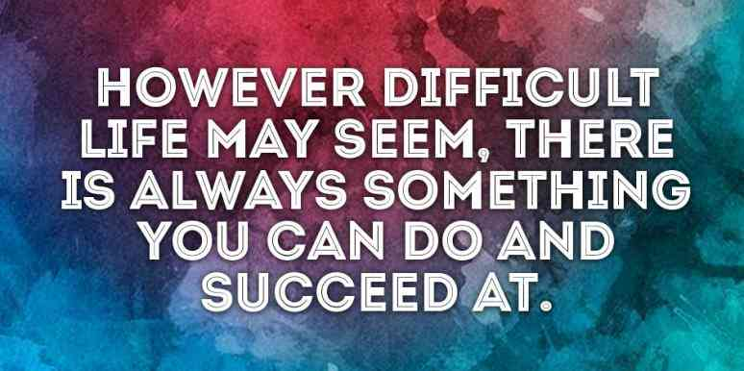

Slide 18
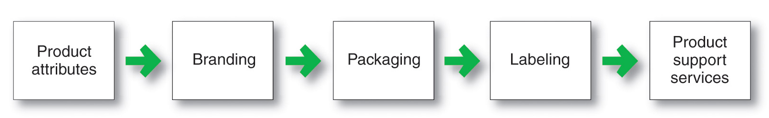
Individual Product Decisions
The important decisions in the development and marketing of individual products and services.

Slide 19
Product Attributes
Product attributes are the benefits of the product or service
Quality
Features
Style and design

Slide 20
Product Quality
Freedom from defects, Ability of a Product to Perform Its Functions, “Quality is when our customers come back and our products don’t”; Includes Level(performance quality) & Consistency(conformance quality)
Product Features
Help to Differentiate the Product from Those of the Competition
Product Style
& Design
Style describes the appearance of the product
Design contributes to a product’s usefulness as well as to its looks. Product designers should think less about product attributes and technical specifications and more about how customers will use and benefit from the product.

Slide 21
Branding
A name, term, sign, symbol, or design, or a combination of these, intended to identify the goods or services of one seller or group of sellers and to differentiate them from the competitors.

Slide 22
Packaging
Activity of designing and producing the container or wrapper for a product.
Packaging used to just contain and protect the product.

Slide 23
Labeling
Printed information appearing on or with the package.
Performs several functions:
Identifies product or brand
Describes several things about the product
Promotes the product through attractive graphics.

Slide 24
Product - Support Services
Companies should design its support services to profitably meet the needs of target customers and gain competitive advantage.
How?
Step1.Survey customers to assess the value of current services and to obtain ideas for new services.
Step2.Assess costs of providing desired services.
Step3.Develop a package of services to delight customers and yield profits to the company.

Slide 25
Product Line Decisions
A product line is a group of products that are closely related because they function in a similar manner, are sold to the same customer groups, are marketed through the same types of outlets, or fall within given price ranges

Slide 26
Product Line Decisions
Product line length is the number of items in the product line. A company can expand its product line in two ways:
Line stretching (change of quality- upward, downward or both way)
Line filling (change size or style)

Slide 27
Product Line Decisions
Product mix consists of all the products and items that a particular seller offers for sale
Width (no. of diff. product lines a company carries)
Length (total no. of items the company carries within its product lines)
Depth (no. of versions offered of each product in the line)
Consistency (how closely related the various product lines are in end use, production requirements, distribution channels, or some other way.)

Slide 28
Branding Strategy: Building Strong Brands
The major brand strategy decisions involve brand positioning, brand name selection, brand sponsorship, and brand development
Brand positioning
Brand Sponsorship
Manufacturer’s brand
Brand Development
Line extension
Brand name selection
Brand extension
Multibrands
New Brands
Private brands
Licensing
Co branding
Selection
Protection
Attributes
Benefits
Beliefs and values

Slide 29
Brand Positioning
Companies can position brands at any of the three levels:
Product attributes (pamper: absorption, fit, disposable)
Product benefits (pamper: skin-health benefits from dryness, ”there are fewer wet bottoms in the world because of us”)
Product beliefs and values (pamper: helping mom with her baby’s development)

Slide 30
Brand Name Selection
Desirable qualities
Suggest benefits and qualities
Easy to pronounce, recognize, and remember
Distinctive
Extendable
Translatable for the global economy
Capable of registration and legal protection

Slide 31
Brand Sponsorship
Manufacturer’s (National) brand
Private (store) brand
Licensed brand
Co-brand

Slide 32
Brand Development Strategies
Product Category
Existing
New
Line Extension
(Colgate toothpaste, different flavors)
Brand Extension
(Colgate: Toothpaste & Toothbrush)
Multibrands
(Unilever: Lux, Dove & Sunsilk Shampoo)
New Brand
(Olper’s(milk), Olfrute(juices))
Existing
Brand Name
New

Slide 33


Slide 34
Services Marketing

Slide 35
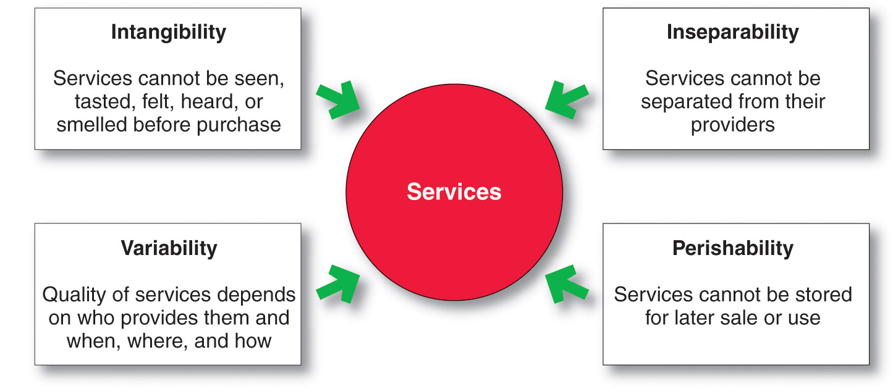
Nature and Characteristics of a Service

Slide 36
Marketing Strategies for Service Firms
In addition to traditional marketing strategies, service firms often require additional strategies
Service-profit chain
Internal marketing
Interactive marketing

Slide 37
Marketing Strategies for Service Firms
Service-profit chain links service firm profits with employee and customer satisfaction
Internal service quality
Satisfied and productive service employees
Greater service value
Satisfied and loyal customers
Healthy service profits and growth

Slide 38
Three types of service marketing
Company
Internal Marketing
External Marketing
Employee
Customer
Interactive Marketing

Slide 39
Marketing Strategies for Service Firms
Internal marketing means that the service firm must orient and motivate its customer contact employees and supporting service people to work as a team to provide customer satisfaction
Internal marketing must precede external marketing

Slide 40
Marketing Strategies for Service Firms
Interactive marketing means that service quality depends heavily on the quality of the buyer–seller interaction during the service encounter
Service differentiation
Service quality
Service productivity

Slide 41
Marketing Strategies for Service Firms
Managing service differentiation creates a competitive advantage from the offer, delivery, and image of the service
Offer can include distinctive features
Delivery can include more able and reliable customer contact people, environment, or process
Image can include symbols and branding

Slide 42
Marketing Strategies for Service Firms
Managing service quality provides a competitive advantage by delivering consistently higher quality than its competitors
Service quality always varies depending on interactions between employees and customers

Slide 43
Marketing Strategies for Service Firms
Managing service productivity refers to the cost side of marketing strategies for service firms
Employee recruiting, hiring, and training strategies
Service quantity and quality strategies

Slide 44
